Slide 1
Bell Work
What might you learn about a place or a historical period by studying a painting?

Slide 2
Bell Work
What is the most important meeting place in all of history?
What city and country will you find this place?

Slide 3
Bell Work
On page 12 of your textbook, you will find two photos of maps. Read what is written under the maps and answer the questions.

Slide 4
Bell Work
On page 14 of your textbook, you will see a photograph of soldiers. Read what is written below the photo and answer the question.

Slide 5
Bell Work
Why do historians draw different conclusions about events of the past? pg. 13-14
iPad, 3-4

Slide 6
Bell Work
Who was Genghis Khan?

Slide 7
Bell Work
Look through the 13 chapter titles in your book and pick three chapter titles that you want to research.
Explain you answer.

Slide 8
Bell Work
Go to the following website, look at their “about” page and explain if it would be a reliable research site. PICK ONE SITE
www.nasa.gov
www.ucf.edu
www.un.org

Slide 9
Bell Work
Go to Wikipedia.org
Go to the link for “English”
Go to the link for “about” – bar on left side
Read the first three paragraphs in the about section.
Evaluate why Wikipedia would or would not be a reliable research site.

Slide 10
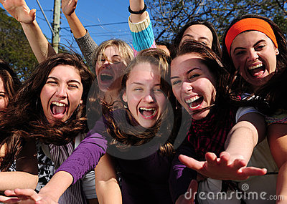
Bell Work
Happy Kahoot Day!

